Slide 1
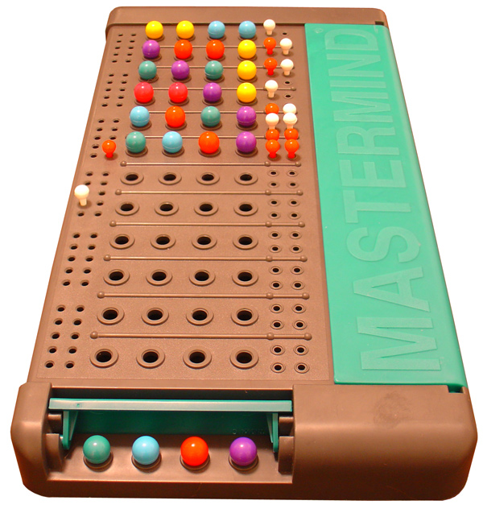
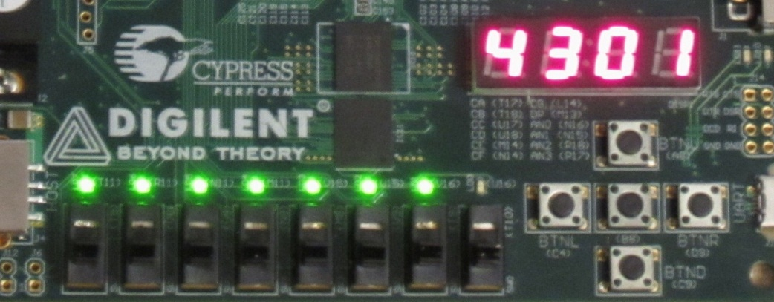
Mastermind Solver

Slide 2
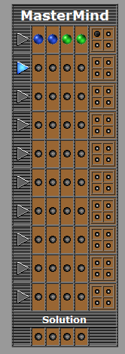

Slide 3
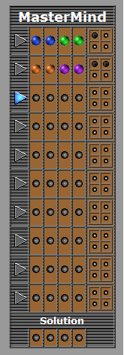

Slide 4
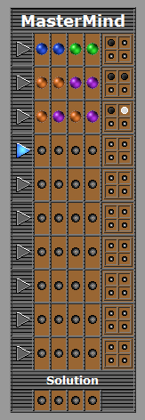

Slide 5
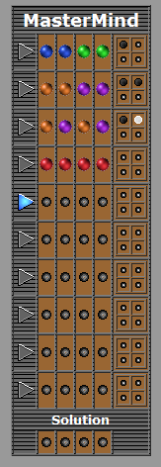

Slide 6
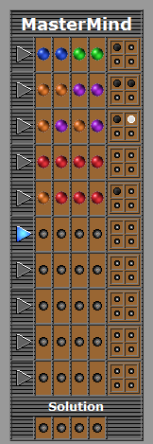

Slide 7
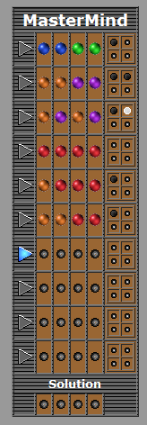

Slide 8
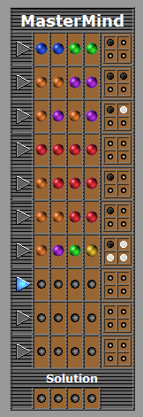

Slide 9
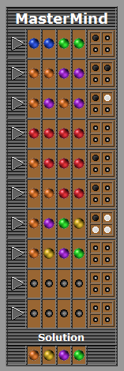

Slide 10
First task: getting a solver algorithm
Available algorithms
5-guess algorithm
Could always get the code in 5 guesses or less
However, required keeping track of all 1296 possible solution codes
Thus, it was going to take quite a large number of hardware components to implement
Other similarly hardware-intensive algorithms (some even faster)
Our decision
We wanted to accomplish something original
→ Come up with our own algorithm
→ Instead of having the usual goal of solving the code as fast as possible, have the new goal of reducing hardware usage
-- If that means taking more guesses, that is OK, as long as the algorithm solves the code within 10 guesses

Slide 11
Our algorithm
The steps
Guess 0000 → gets the number of 0s in the code
Guess 1111 → gets the number of 1s in the code
Guess 2222 → gets the number of 2s in the code
Guess 3333 → gets the number of 3s in the code
Guess 4444 → gets the number of 4s and 5s in the code
Now the program knows what numbers make up the code, but not their ordering yet
Guess the correct numbers, from greatest to lowest
Using the locational information obtained in guess 6 and in subsequent guesses, our algorithm can reach the correctly ordered code within the remaining 4 guesses
Question: Is this the fastest way to solve the code? Definitely not – but that’s not our goal. As long as the algorithm gets the code within 10 guesses, we want it to be as lazy as possible, so that it uses the least hardware possible.

Slide 12
The re-ordering part of the algorithm
AAAB | AABB |  | AABC |  |  | ABCD
2 s.m. | 0 s.m. | 2 s.m. | 0 s.m. | 1 s.m. | 2 s.m. | 0 s.m. | 1 s.m. | 2 s.m.
AABA | BBAA | ABAB | BCAA | ACAB | AACB | BADC | ADBC | ABDC
ABAA |  | BABA | CBAA | ABCA | ACBA | BCDA | ACDB | ADCB
BAAA |  | ABBA |  | CAAB | ABAC | BDAC | DBAC | ACBD
 |  | BAAB |  | BACA | CABA | CADB | CBDA | DBCA
 |  |  |  |  | BAAC | CDAB | DACB | CBAD
 |  |  |  |  |  | CDBA | BDCA | BACD
 |  |  |  |  |  | DABC | CABD
 |  |  |  |  |  | DCAB | BCAD
 |  |  |  |  |  | DCBA
When it’s possible to just iterate through possibilities to solve the code within 10 guesses, as in the 5 left-most cases, the algorithm does that, because the “dumb” method requires less hardware than checking conditions after each guess
Effectively, the hardware only has to remember 51 codes: these 45 (abstract) codes plus the 6 AAAA codes

Slide 13
Algorithm verification and implementation
Verification
We tested the algorithm by simulating all possible Mastermind games in a C++ program, and verifying that the number of guesses needed to reach the solution was always <= 10.
Doing this, we actually caught a problem with the algorithm – there was a particular format of Mastermind code that the algorithm wasn’t solving within 10 guesses.
Implementation difficulties
Apparently, Verilog does not support nested loops
Fitting algorithm to a state machine was awkward (illustrated next slide)

Slide 14
Implementing the algorithm in a state machine
Guess and wait for user response
Initial
Check for problems
Algorithm
We thought that putting the algorithm all in one state was the simplest design; however, this meant that a lot of logic was crammed into one state (this turned out to be a problem)

Slide 15

Interacting with the game
Computer’s current guess
Reset
# of s.m.
(non-encoded)
# of w.m.
(non-encoded)
Respond
(had to be debounced)
# of guesses used
(non-encoded)
Guiding principle: simple, intuitive use

Slide 16
Major bugs we had to fix
Random SSD outputs
The SSD cathodes were high or low at random, without displaying the characters we wanted.
Solution: the problem went away when we made sure all of the regs in the state machine were initialized in the Initial state, although we’re not sure why this helped.
Debouncer and state machine unreliability
We had this really weird problem where about half of the time, the SCEN of the debouncer would be high for multiple clocks, or the state machine would skip a state. Giving the same sequence of inputs to the board sometimes triggered the problems, sometimes not, unpredictably.
Solution: the clock speed was too fast. The large number of logic gates in the debouncer and the algorithm state meant that they often could not keep up with the clock.

Slide 17
demonstration!

